Slide 1
Guided Capstone – Big Mountain Pricing Strategy
Using data to guide pricing and growth decisions

Slide 2
Problem Identification
Big Mountain wants to understand if its ticket pricing is aligned with the market
There’s an opportunity to explore whether the resort could charge more based on its facilities
The goal is to find a balance between staying competitive and increasing revenue

Slide 3
Recommendation
The data suggests Big Mountain can support a modest increase in ticket price
Small improvements in key areas (runs, vertical drop, lifts) have the biggest impact
Instead of a big change, a gradual price increase would be the safest approach

Slide 4
Key Findings
Big Mountain is already priced in the mid-to-high range compared to similar resorts
A few key features strongly influence pricing:
Number of runs
Vertical drop
Total chairs
Other features, like longest run, don’t make a big difference in price

Slide 5
Modeling Approach
Used two models:
Linear Regression
Random Forest (selected)
Random Forest performed better based on accuracy
Feature importance helped identify key pricing drivers

Slide 6
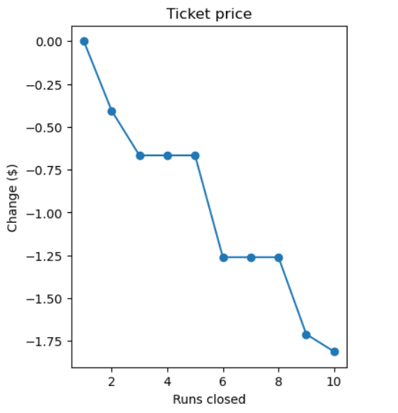
Scenario Analysis
Scenario 2 → strongest increase in price & revenue
Scenario 3 → small additional improvement
Scenario 6 → minimal impact

Slide 7
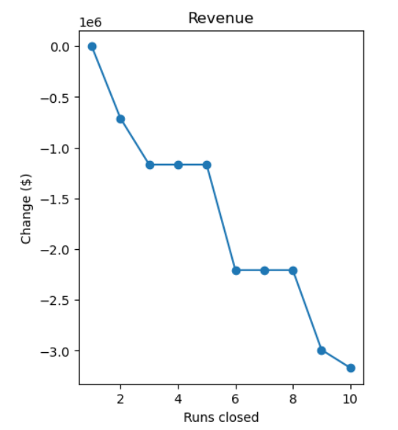
Revenue Impact: Business Perspective
Facility upgrades can increase overall revenue
Additional costs (like chair lift) can be offset by price increases
Testing changes gradually reduces risk

Slide 8
Summary & Conclusion
The analysis shows clear potential to increase pricing in a controlled way
Focusing on the right improvements can strengthen both value and revenue
A gradual, test-and-learn approach is the best path forward
Overall, the model provides a strong foundation for future decisions

